Slide 1
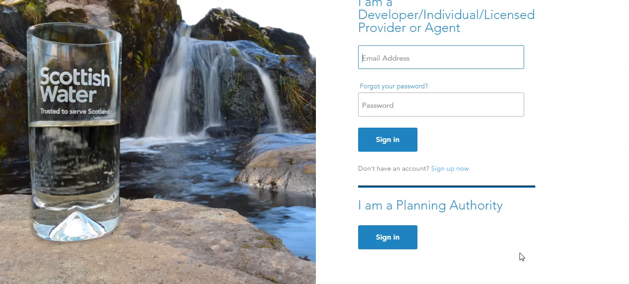
Registering an organisation

Slide 2
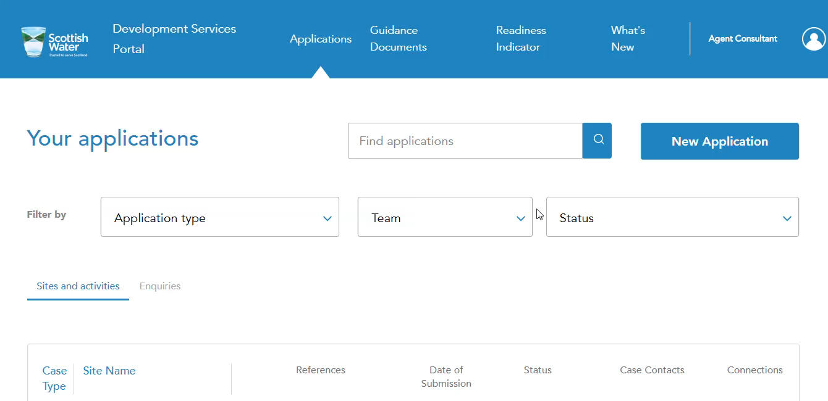
Agent – Adding a Team Member

Slide 3
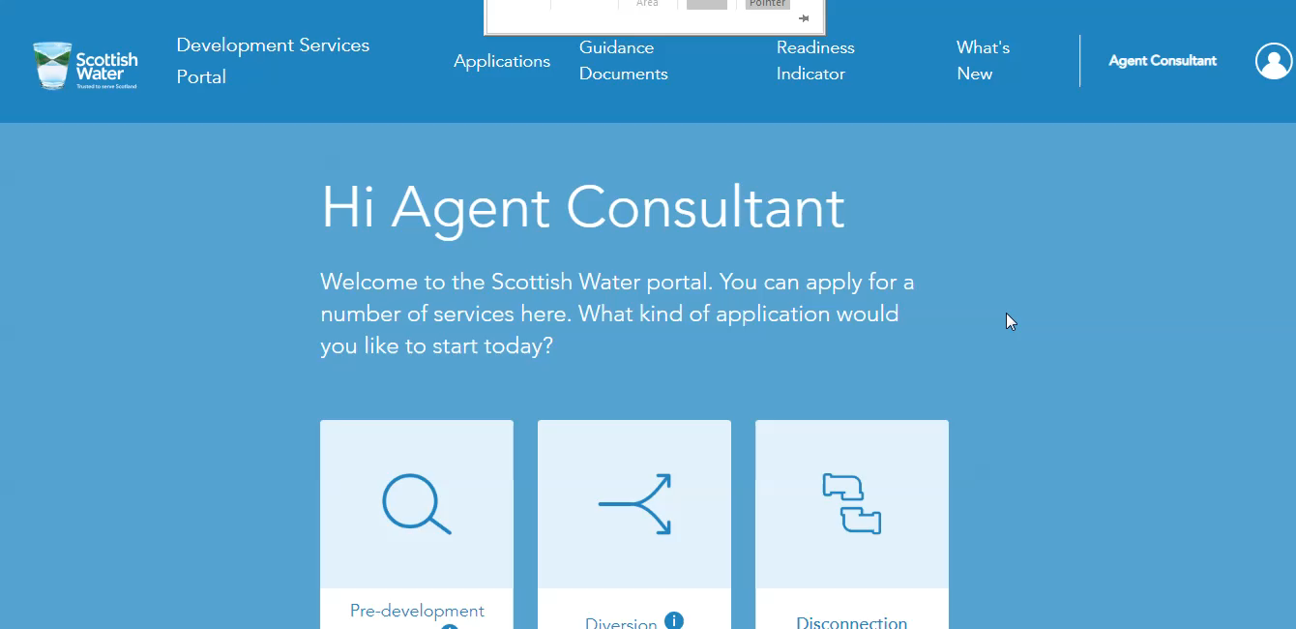
Colleague registering by invite.

Slide 4
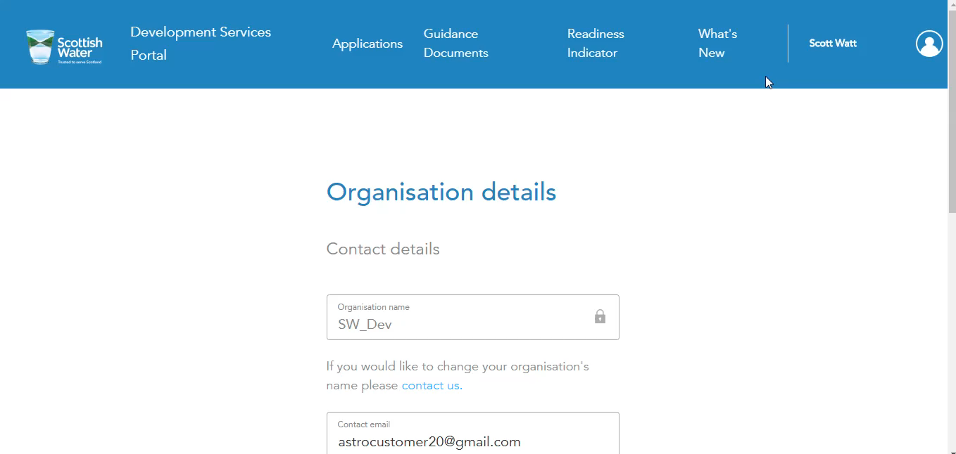
Change Case Manager and End Customer

Slide 5
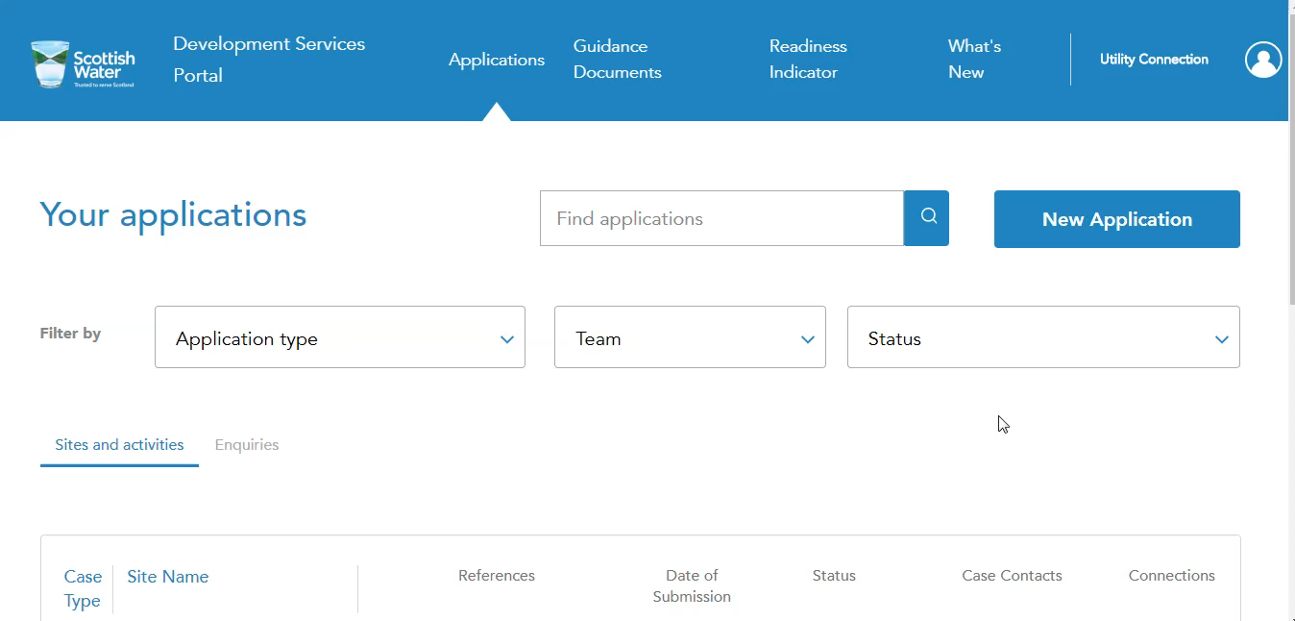
Difference between Admin and Member – More Detail

Slide 6
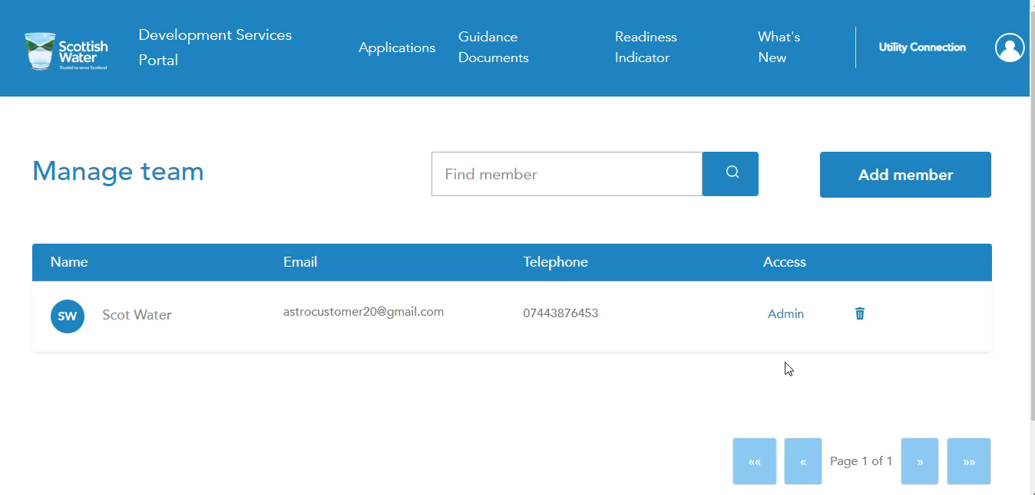
Case Manager and End Customer – more detail

