Slide 1
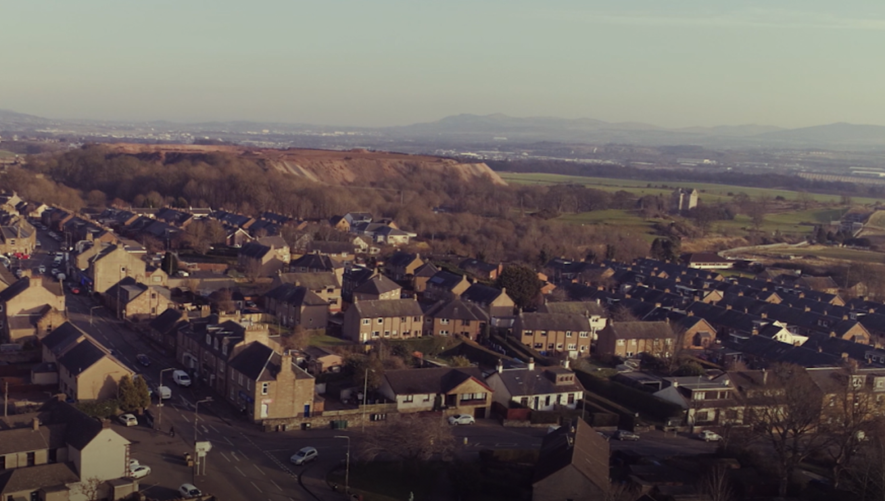

New Winchburgh Wastewater Treatment Works
Scottish Water / ESD update to Winchburgh Community Council
8 March 2021

Slide 2

Who we are…..
Natalie Walker – Corporate Affairs – Scottish Water
Scottish Water - Water and wastewater provider for Scotland
Publicly owned and funded
Responsible for 60,000 miles of water and waste pipe
Operate 1,800 Wastewater Treatment Works
Dougie McInnes – Project Manager, ESD
Caroline McKenzie – Customer Manager, ESD
ESD will carry out this work on Scottish Water’s behalf

Slide 3
PRESENTATION
UPDATE ON TEMPORARY WWTW
DETAILS OF NEW PERMANENT WWTW SOLUTION
SITE LAYOUT AND ACCESS ROUTE
ESTIMATED TIMELINE FOR WORK
UPDATE ON WATER PRESSURE
NEXT STEPS
QUESTIONS

Slide 4
Update on Winchburgh WwTW
Temporary WwTW completed and operational
Will operate until permanent WwTW operational
Thanks to community for patience
Next Steps
Priority work continuing - carried out under Covid operating guidance
Multi-million pound investment to construct permanent WwTW
Help enable growth
Will be responsible / do all we can to cause minimum disruption
Work with the community to deliver messages on how they can help keep water network flowing

Slide 5
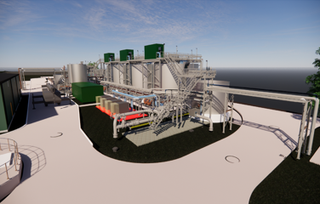
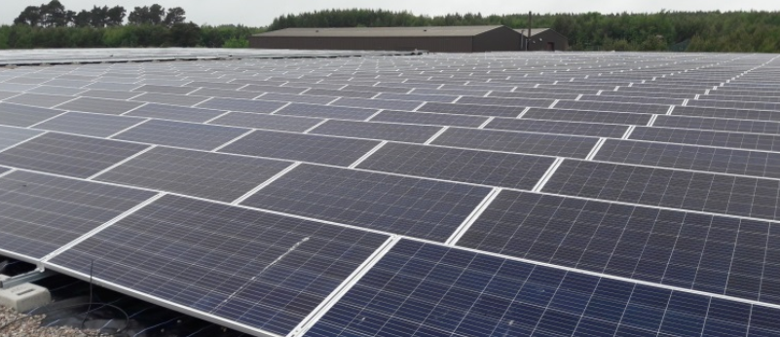
State-of-the-art technology
Nereda technology
Environmental Benefits
Compact designs – ¾ less land needed
Treats to higher standard
Lower energy consumption
PV panels to be added – converts energy from sun to electric power
Use of steel rather than concrete

Slide 6
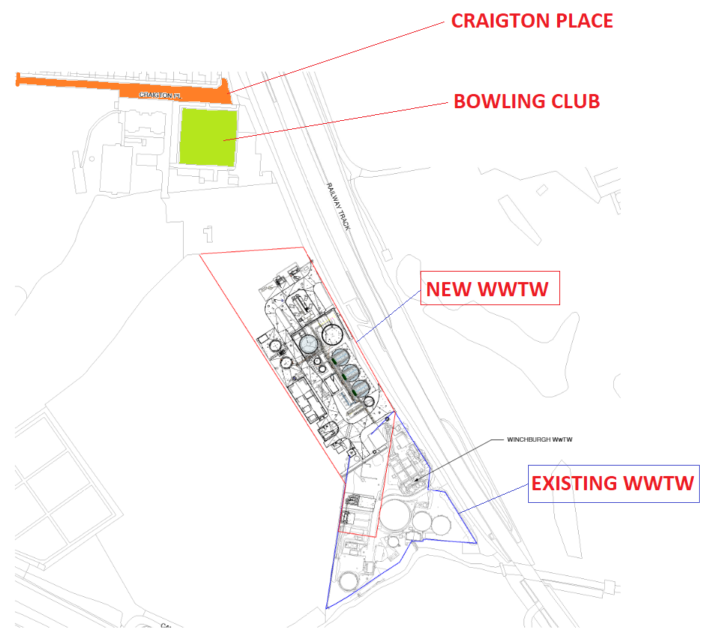
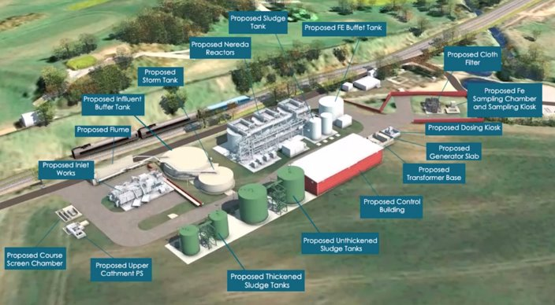
SSIG
SITE LOCATION AND PROPOSED LAYOUT
3D Model of Proposed Works
NOTE: Some minor changes are expected to layout as a result of detailed design which is ongoing

Slide 7

Site Access Road

Slide 8
Estimated Site Traffic Movements
Material Removal
18,500 tonnes of material to be removed from site
  Aim to reuse on site or on other local developments
Estimated up to 50 wagons arriving to and exiting from site over a 6 week period (total of 925 wagons required)
New Material to Site
Estimated 500 concrete lorries required over a 9 month period (Jan 22 – Sept 22)
Frequency varies throughout programme

Slide 9
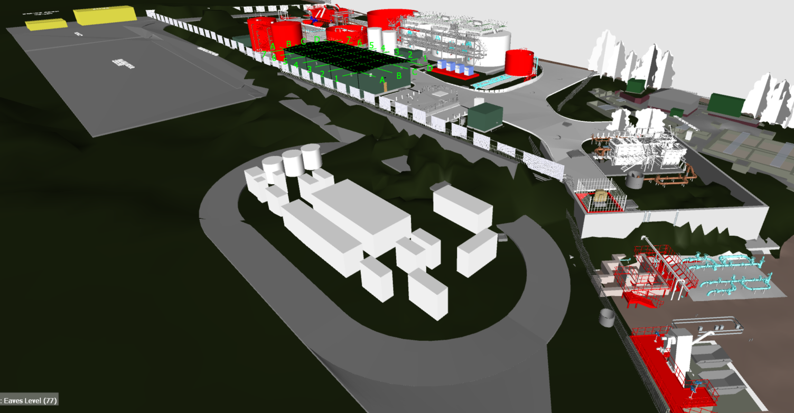
E
ESTIMATED TIMELINE OF WORKS
3D Model for Site Layout
Mar 21: Ground Investigation complete
Summer 21: Planned start on site
Autumn 21: Completion of enabling works
Autumn 22: Completion of civil works
Summer 23: Construction complete
Nov 23: Commissioning complete

Slide 10
Water pressure update - Winchburgh
Recently carried out a temporary rezone to parts of Winchburgh and Newton Village
Longer term we will split village into 2 zones
West Winchburgh supplied from Waterston tank - East Winchburgh from a new link to South Queensferry
More resilient water supply to customers
Continue to report any incidents to 24/7 customer services helpline on 0800 0778 778 elp@scottishwater.co.uk

Slide 11

What next?
Continue to liaise with and update community on new WwTW
Attend future Community Council meetings
Hold community event later this year (COVID permitting)
Visit schools/attend events to discuss project and share 3Ps messaging
Volunteer programme – can help in community
Any ideas – let us know!
ANY QUESTIONS?

